Slide 1

Influences on World literacy
Michael Ippolito
DATA606
Final project

Slide 2

DATA606 - Influences on World literacy
Abstract
It may be self-evident that the amount of money spent on education by a country will have an impact on the country's literacy rate. But is there a statistically significant relationship? And can that relationship be quantified using a predictive model? It is further presumed that literacy rates will be lower in poorer regions of the world and in those having forms of government in which the head of state holds more power and has less accountability to his or her constituents. This project sought to validate those assumptions and to generate a model that will predict the change in literacy rate based on the studied parameters.
The study confirms that literacy rate is impacted positively by educational spending. There is also evidence to suggest a statistically significant relationship between literacy and both the country’s geographic subregion and its form of government, although it is noted that not all conditions were sufficiently satisfied for the analysis. The most significant finding is that government spending on educational strongly influences a country’s literacy rate, with over a five-percent rise in literacy with every percentage increase in spending.
One topic for additional consideration that arose from this project is whether it is possible to quantify functional illiteracy and to discern the relationship between it and the conventionally accepted literacy rate.

Slide 3
Influences on World literacy
Overview
Research problem
Data exploration
ANOVA analysis
Linear model
Conclusions

Slide 4
DATA606 - Influences on World literacy
RESEARCH PROBLEM

Slide 5




Influences on World literacy
Literacy rate
(numerical response variable)
Government spending on education
(numerical explanatory variable)
Geographical region of the world
(categorical explanatory variable)
Form of government
(categorical explanatory variable)

Slide 6
Influences on World literacy
Definition of literacy
UNESCO: “The ability to use reading, writing and numeracy skills for effective functioning and development of the individual and the community. A person is literate who can, with understanding, both read and write a short statement on his or her everyday life.”
(https://www.fipfoundation.org/pictograms-support/about-health-literacy/#:~:text=UNESCO%20provides%20a%20definition%20of,his%20or%20her%20everyday%20life.%E2%80%9D)

Slide 7
DATA606 - Influences on World literacy
DATA EXPLORATION

Slide 8
DATA606 - Influences on World literacy
Data Sources
Regional data
https://github.com/lukes/ISO-3166-Countries-with-Regional-Codes/blob/master/all/all.csv
Government spending on education
https://data.worldbank.org/indicator/SE.XPD.TOTL.GD.ZS
Literacy rates
https://commons.wikimedia.org/wiki/Data:Cross-country_literacy_rates_-_World_Bank,_CIA_World_Factbook,_and_other_sources_(OWID_2762).tab
Forms of government
https://en.wikipedia.org/wiki/List_of_countries_by_system_of_government

Slide 9
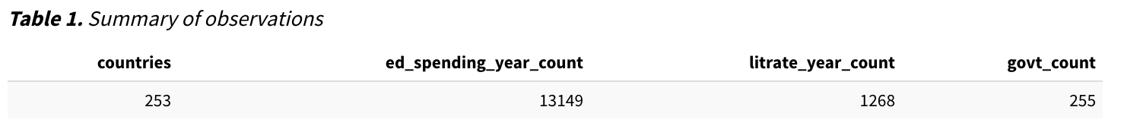
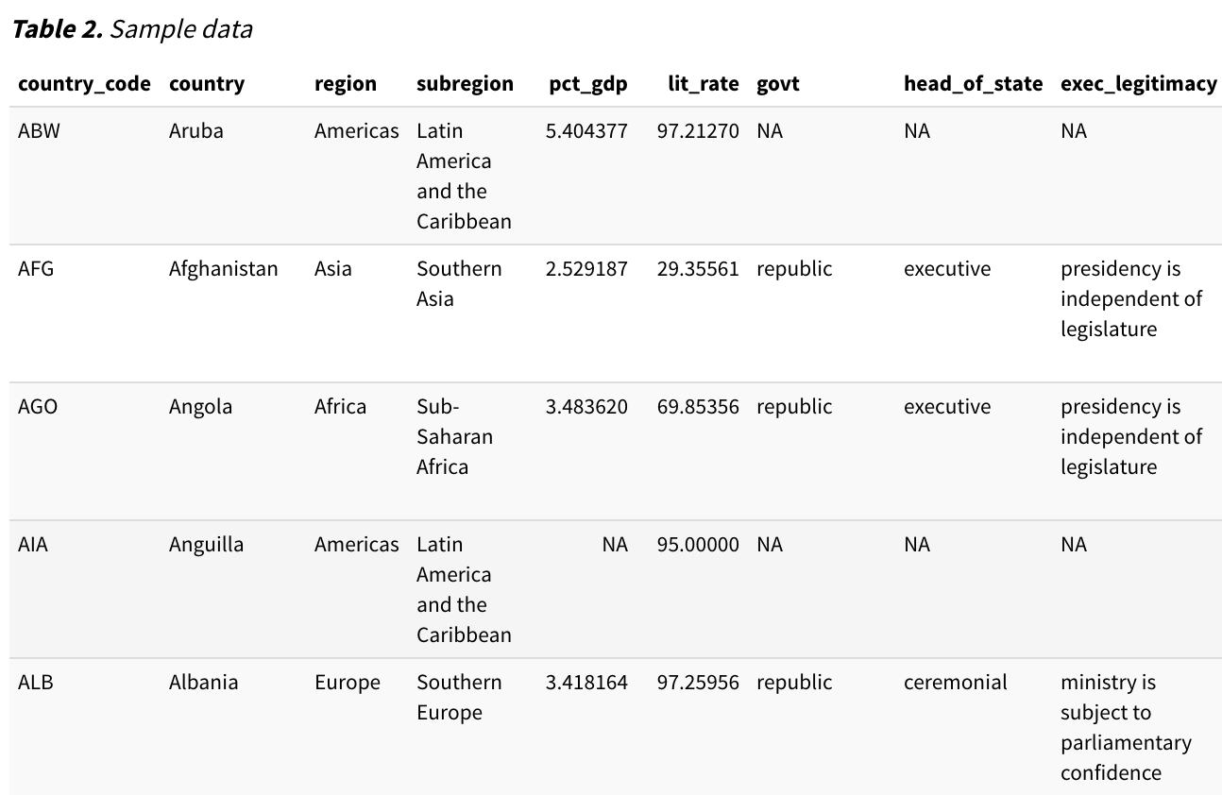
DATA606 - Influences on World literacy

Slide 10
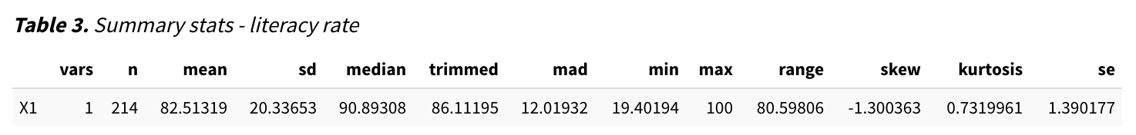
Influences on World literacy

Slide 11
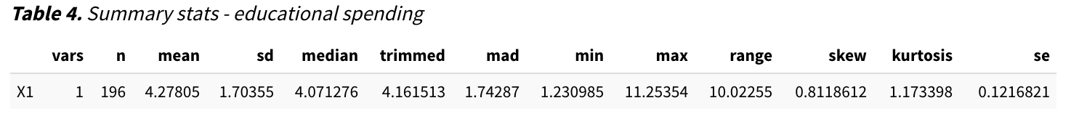
Influences on World literacy

Slide 12
DATA606 - Influences on World literacy

Slide 13
DATA606 - Influences on World literacy

Slide 14
Influences on World literacy

Slide 15
Influences on World literacy

Slide 16
Influences on World literacy

Slide 17
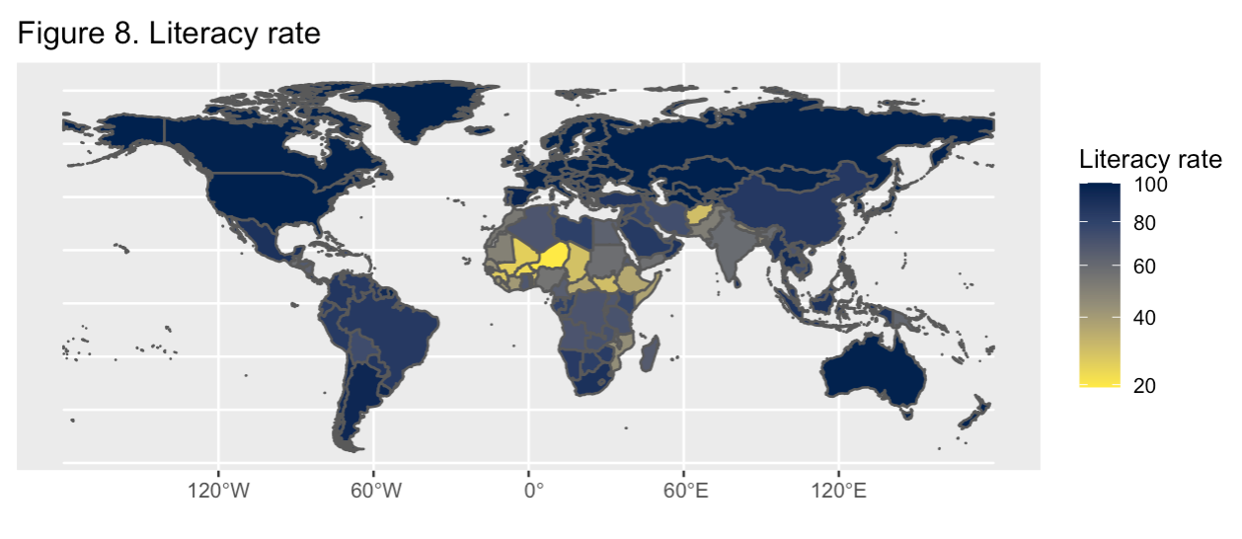
Influences on World literacy

Slide 18
DATA606 - Influences on World literacy

Slide 19
DATA606 - Influences on World literacy

Slide 20
DATA606 - Influences on World literacy

Slide 21
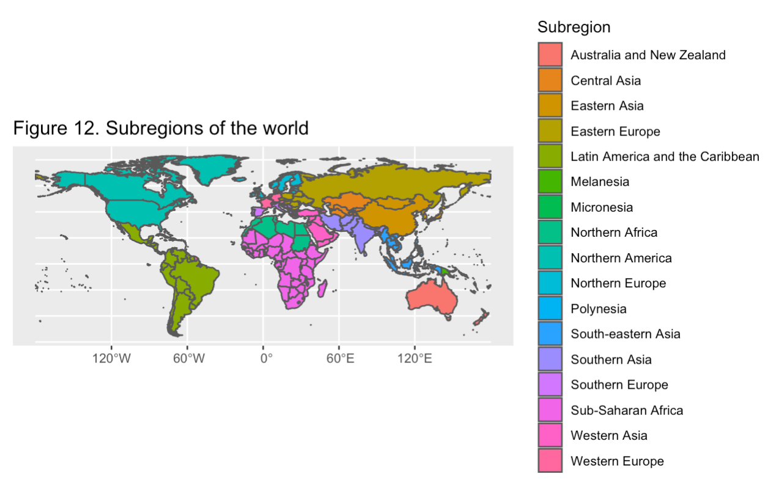
Influences on World literacy

Slide 22
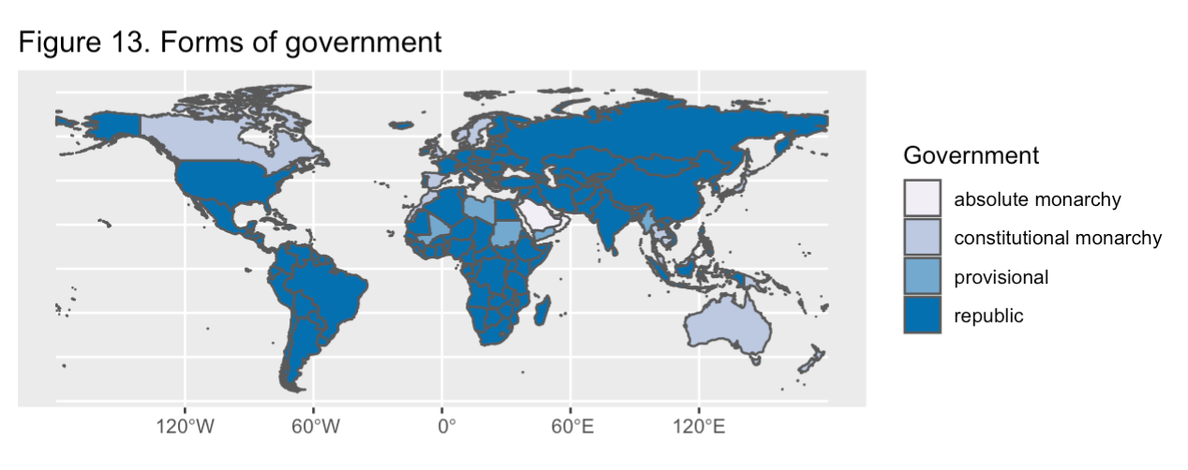
Influences on World literacy

Slide 23
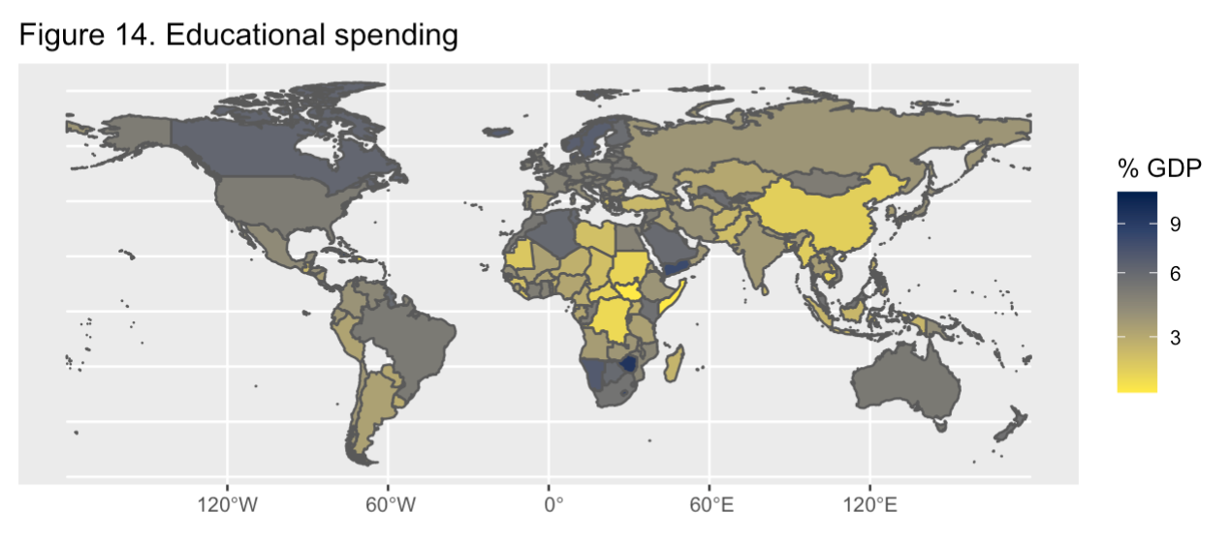
Influences on World literacy

Slide 24
DATA606 - Influences on World literacy
ANOVA ANALYSIS

Slide 25
Influences on World literacy
ANOVA Analysis
Educational spending vs subregion
Df Sum Sq Mean Sq F value Pr(>F)
Subregion. 16 128.1 8.006 3.273 5.33e-05 ***
Residuals 179 437.8 2.446
Educational spending vs government type
Df Sum Sq Mean Sq F value Pr(>F)
govt_type_short 9 56.2 6.244 2.348 0.0159 *
Residuals 174 462.8 2.660
Literacy rate vs subregion
Df Sum Sq Mean Sq F value Pr(>F)
subregion 16 48057 3003.5 14.78 <2e-16 ***
Residuals 197 40035 203.2
Literacy rate vs government type
Df Sum Sq Mean Sq F value Pr(>F)
govt_type_short 9 14384 1598 4.25 5.15e-05 ***
Residuals 181 68065 376

Slide 26
DATA606 - Influences on World literacy

Slide 27
DATA606 - Influences on World literacy

Slide 28
DATA606 - Influences on World literacy
LINEAR MODEL

Slide 29
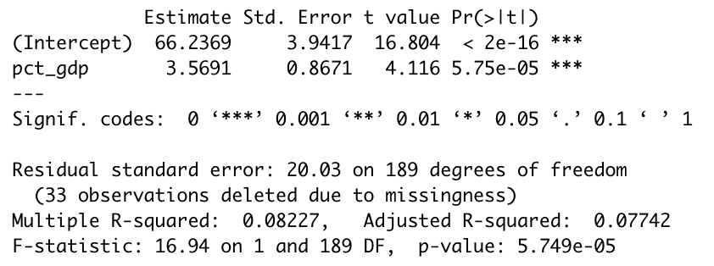
Influences on World literacy

Slide 30
Influences on World literacy

Slide 31
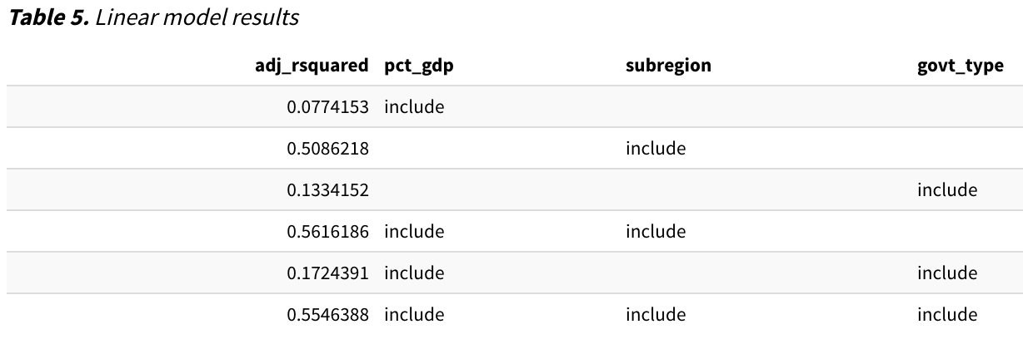
Influences on World literacy
Forward Selection Results
best

Slide 32
Influences on World literacy
Best Model
Estimate Std. Error t value Pr(>|t|)
(Intercept) 85.7399 10.4087 8.237 4.17e-14 ***
pct_gdp 2.4785 0.6754 3.670 0.000323 ***
subregionCentral Asia 3.2480 11.5778 0.281 0.779399
subregionEastern Asia 0.5249 11.3536 0.046 0.963178
subregionEastern Europe 1.6350 10.7033 0.153 0.878771
subregionLatin America and the Caribbean -9.9564 10.0655 -0.989 0.323966
subregionMelanesia -22.3053 11.9564 -1.866 0.063797 .
subregionMicronesia -11.9280 14.0872 -0.847 0.398316
subregionNorthern Africa -30.1010 11.2929 -2.665 0.008416 **
subregionNorthern America 1.6622 12.6132 0.132 0.895308
subregionNorthern Europe -0.8357 10.6984 -0.078 0.937825
subregionPolynesia 1.5042 13.8114 0.109 0.913402
subregionSouth-eastern Asia -11.1689 10.6730 -1.046 0.296810
subregionSouthern Asia -33.3619 10.8698 -3.069 0.002492 **
subregionSouthern Europe 1.0278 10.5937 0.097 0.922821
subregionSub-Saharan Africa -35.9655 10.0097 -3.593 0.000426 ***
subregionWestern Asia -7.5503 10.3518 -0.729 0.466760
subregionWestern Europe 3.0897 10.8222 0.285 0.775604

Slide 33
DATA606 - Influences on World literacy
CONCLUSIONS

Slide 34
Influences on World literacy
Conclusions
Literacy rate has positive, linear relationship with government spending on education
Statistically significant relationship between geographic region and both educational spending and literacy rate
Statistically significant relationship between government type and both educational spending and literacy rate

Slide 35
Influences on World literacy
Conclusions, cont’d
Micronesia has highest spending rate on education, but is 90% funded by the U.S.
(in exchange for U.S. access to islands for military purposes)
Literacy rate has an over five-percent increase for every percent of GDP spent on education

Slide 36
Influences on World literacy
Conclusions (cont’d)
Lowest literacy rates are in Sub-Saharan Africa
Highest literacy rates are in Northern Europe and Central Asia
(but Central Asia most likely has high rate of functional illiteracy)
UNESCO: “A person is functionally illiterate who cannot engage in all those activities in which literacy is required for effective functioning of his group and community and also for enabling him to continue to use reading, writing, and calculation for his own and the community’s development.” (https://www.ncbi.nlm.nih.gov/pmc/articles/PMC5102880/)

Slide 37
DATA606 - Influences on World literacy
References
https://github.com/lukes/ISO-3166-Countries-with-Regional-Codes/blob/master/all/all.csv
https://data.worldbank.org/indicator/SE.XPD.TOTL.GD.ZS
https://commons.wikimedia.org/wiki/Data:Cross-country_literacy_rates_-_World_Bank,_CIA_World_Factbook,_and_other_sources_(OWID_2762).tab
https://en.wikipedia.org/wiki/List_of_countries_by_system_of_government
https://www.dvv-international.de/en/adult-education-and-development/editions/aed-662006/education-for-all-and-literacy/review-of-central-asian-countries
https://www.fipfoundation.org/pictograms-support/about-health-literacy/#:~:text=UNESCO%20provides%20a%20definition%20of,his%20or%20her%20everyday%20life.%E2%80%9D
https://www.grassrootinstitute.org/2016/09/us-policies-may-hurt-micronesians-more-than-they-help/
https://www.ncbi.nlm.nih.gov/pmc/articles/PMC5102880/

